Slide 1
Surgical Video Analysis
AIML PROJECT ELECTIVE TERM II 2022-23
WEEK III, IV MAR 18-APR 04

Slide 2
Task Assigned
Task: Surgical tool localization
Dataset: m2cai-16 tool locations

Slide 3
This week
Complete overview of YOLOv7

Slide 4
Introduction
Architecture and training process optimization
Model re-parameterization
Dynamic label assignment
Trainable bag-of-freebies: modules and methods to improve accuracy without increasing inference cost
Used for
More robust loss function
More efficient labelling
More optimized training process

Slide 5
Model re-parameterization
Model re-parameterization
Model-level
Train multiple identical models and avg the weights
Weighted average of the weights at different iterations
Module-level

Slide 6

Model-scaling
Make the model compatible in different CPUs
Scale width, depth, resolution, stage
NAS: Network Automatic Search
Searches automatically for params
Expensive computation
YOLOv7: concatenated – requires compound scaling method

Slide 7

Architecture
Extended efficient layer aggregation networks
Model scaling for concatenation-based models

Slide 8
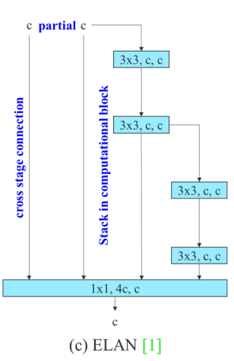
E-ELAN
"By controlling the shortest longest gradient path, a deeper network can learn and converge effectively"
Extension based on the ELAN architecture
Uses expand, shuffle and merge cardinality

Slide 9
E-ELAN – Strategy of change
Firstly, Use group convolution to expand the channel and cardinality of blocks
Secondly, This group parameter(g) and channel multiplier are applied to all the computational blocks of a computational layer
Thirdly, The output feature map of each block will be shuffled into g groups and then concatenated
Finally, we add g groups of feature maps to perform merge cardinality

Slide 10
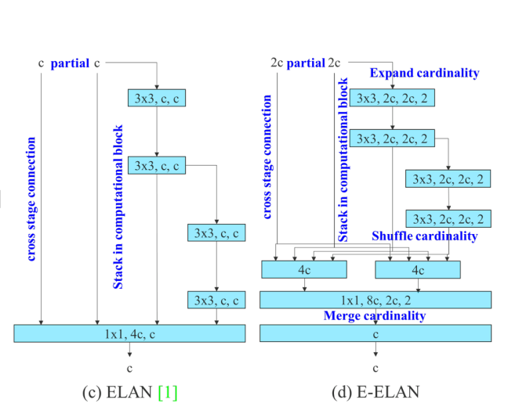

Slide 11
Model scaling for concatenation-based models
Scaling up or down the depth, the in-degree of a translation layer which is immediately after a concatenation-based computational block will decrease or increase.
Need an efficient compound scaling method to maintain the initial properties of the model

